Slide 1
UNIVERSITY INSTITUTE OF COMPUTING
MASTER OF COMPUTER APPLICATIONS
DESIGN AND ANALYSIS OF ALGORITHMS
UNIT-2
DISCOVER . LEARN . EMPOWER

Slide 2
Topics to be covered
Heaps and Heap Sort

Slide 3
Transform and Conquer
Transform and conquer is a design paradigm where a given problem is transformed to another domain. This can be done for familiarity of simplicity. The problem is solved in the new domain. Then, the solutions are converted back to the original domain. In short, transform and conquer proposes two stage solution
First stage involves the transformation to another problem that is more amenable for solution
Second stage involves solving the new problem where the transformed new problem is solved.
Then the solutions are converted back to the original problem.

Slide 4
Variations of Transform and Conquer
Three variants of transform and conquer are as follows:
– Instance Simplification
– Representation Change
– Problem Reduction

Slide 5
Instance simplification
Instance simplification is one variant where the problem transformed to the same problem of simpler or convenient instance. The illustrated example of roman number to Arabic number system is an example of instance simplification.

Slide 6
Representation Change
Representation Change is another variety where the strategy involves the transformation of an instance to a different representation. But this is done without affecting the instance.

Slide 7
Problem reduction
Problem reduction is a strategy that involves a transformation of a problem A to another type of problem B. It is assumed that the solution of problem B already exists. The illustrated example of reduction of computing LCM (Last Common Multiple) in terms of GCD is an example of problem reduction. s GCD. Hypothetically, let us assume that an algorithm exists only for GCD.

Slide 8
Transform and conquer approach
Transform and conquer approach Instead, the array can be sorted and run length of an element can be calculated on the sorted array. Informally, mode finding using presorting is given as follows:
Sort the element of an array.
Calculate the run length of an element
Print the element having longest length
Exit.

Slide 9
Heaps and Heapsort
Definition A heap is a binary tree with keys at its nodes (one key per node) such that:
It is essentially complete, i.e., all its levels are full except possibly the last level, where only some rightmost keys may be missing
The key at each node is ≥ keys at its children (this is called a max-heap)

Slide 10
Illustration of the heap’s definition
a heap
not a heap
not a heap
Note: Heap’s elements are ordered top down (along any path
down from its root), but they are not ordered left to right.

Slide 11
Some Important Properties of a Heap
The root contains the largest key
The subtree rooted at any node of a heap is also a heap
A heap can be represented as an array

Slide 12
Heap Property
Heap Property: All nodes are either greater than or equal to or less than or equal to each of its children. If the parent nodes are greater than their child nodes, heap is called a Max-Heap, and if the parent nodes are smaller than their child nodes, heap is called Min-Heap.

Slide 13
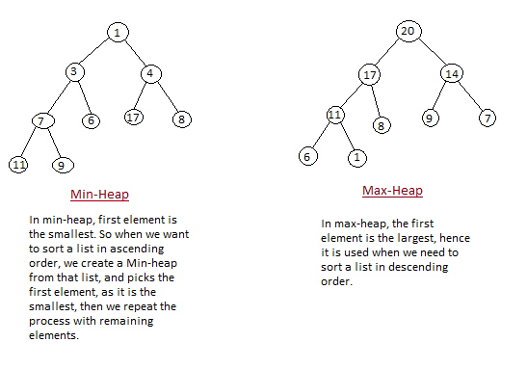
Heap Property

Slide 14
Heap’s Array Representation
Store heap’s elements in an array (whose elements indexed, for convenience, 1 to n) in top-down left-to-right order
Example:
Left child of node j is at 2j
Right child of node j is at 2j+1
Parent of node j is at ⎣j/2⎦
Parental nodes are represented in the first ⎣n/2⎦ locations
9
1 2 3 4 5 6
5
3
9 5 3 1 4 2
1
4
2

Slide 15
Heap Construction (bottom-up)
Step 0: Initialize the structure with keys in the order given
Step 1: Starting with the last (rightmost) parental node, fix the heap rooted at it, if it doesn’t satisfy the heap condition: keep exchanging it with its larger child until the heap condition holds
Step 2: Repeat Step 1 for the preceding parental node

Slide 16
Example of Heap Construction
Construct a heap for the list 2, 9, 7, 6, 5, 8

Slide 17
Heapsort
Stage 1: Construct a heap for a given list of n keys
Stage 2: Repeat operation of root removal n-1 times:
    Exchange keys in the root and in the last (rightmost) leaf
    Decrease heap size by 1
    If necessary, swap new root with larger child until the heap condition holds

Slide 18
Example of Sorting by Heapsort
Sort the list 2, 9, 7, 6, 5, 8 by heapsort
Stage 1 (heap construction) Stage 2 (root/max removal)
1 9 7 6 5 8 9 6 8 2 5 7
2 9 8 6 5 7 7 6 8 2 5 | 9
2 9 8 6 5 7 8 6 7 2 5 | 9
9 2 8 6 5 7 5 6 7 2 | 8 9
9 6 8 2 5 7 7 6 5 2 | 8 9
2 6 5 | 7 8 9
6 2 5 | 7 8 9
5 2 | 6 7 8 9
5 2 | 6 7 8 9
2 | 5 6 7 8 9

Slide 19
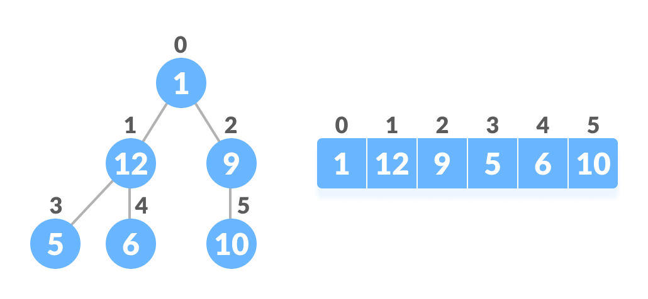
Relationship between Array Indexes and Tree Elements
A complete binary tree has an interesting property that we can use to find the children and parents of any node.
If the index of any element in the array is i, the element in the index 2i+1 will become the left child and element in 2i+2 index will become the right child. Also, the parent of any element at index i is given by the lower bound of (i-1)/2.
Fig: Relationship between array and heap indices

Slide 20
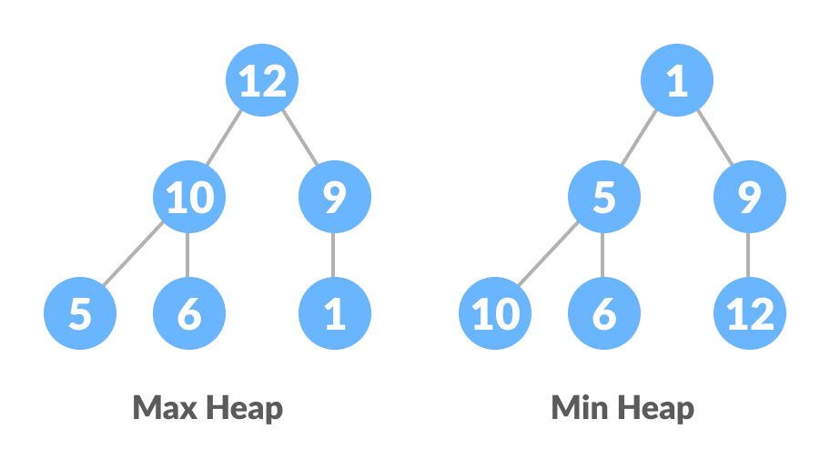
Min Heap and Max Heap
The following example diagram shows Max-Heap and Min-Heap.

Slide 21
How to "heapify" a tree
Starting from a complete binary tree, we can modify it to become a Max-Heap by running a function called heapify on all the non-leaf elements of the heap.
Since heapify uses recursion, it can be difficult to grasp. So let's first think about how you would heapify a tree with just three elements.

Slide 22
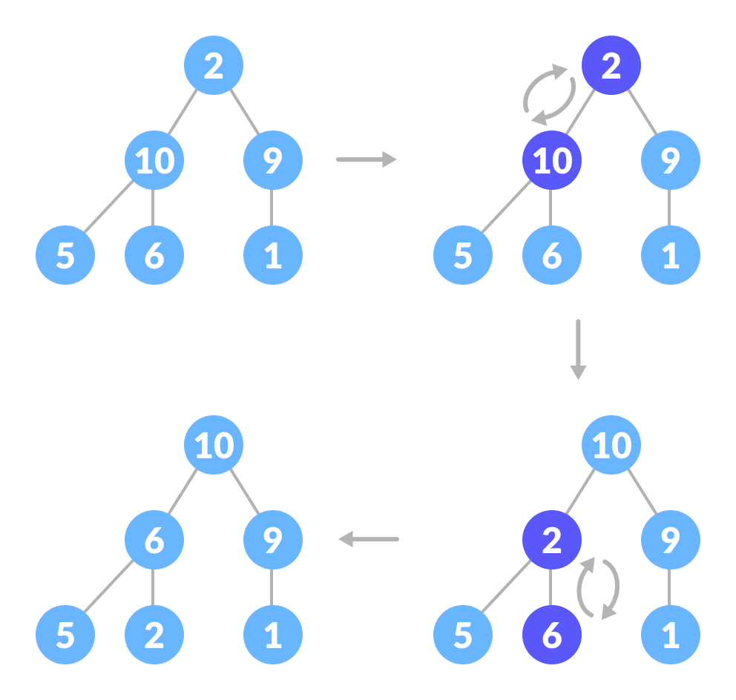
How to heapify root element when its subtrees are max-heaps
The top element isn't a max-heap but all the sub-trees are max-heaps.
To maintain the max-heap property for the entire tree, we will have to keep pushing 2 downwards until it reaches its correct position.

Slide 23
Contd..
Thus, to maintain the max-heap property in a tree where both sub-trees are max-heaps, we need to run heapify on the root element repeatedly until it is larger than its children or it becomes a leaf node.

Slide 24
Build max-heap
To build a max-heap from any tree, we can thus start heapifying each sub-tree from the bottom up and end up with a max-heap after the function is applied to all the elements including the root element.
In the case of a complete tree, the first index of a non-leaf node is given by n/2 - 1. All other nodes after that are leaf-nodes and thus don't need to be heapified.

Slide 25
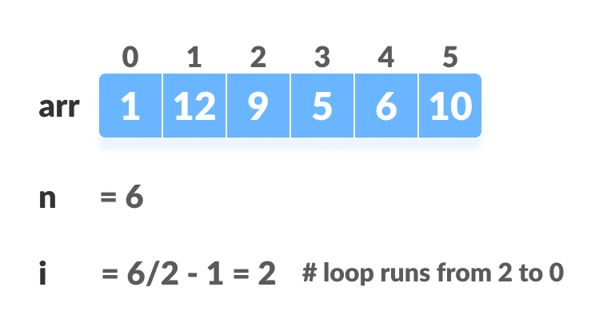
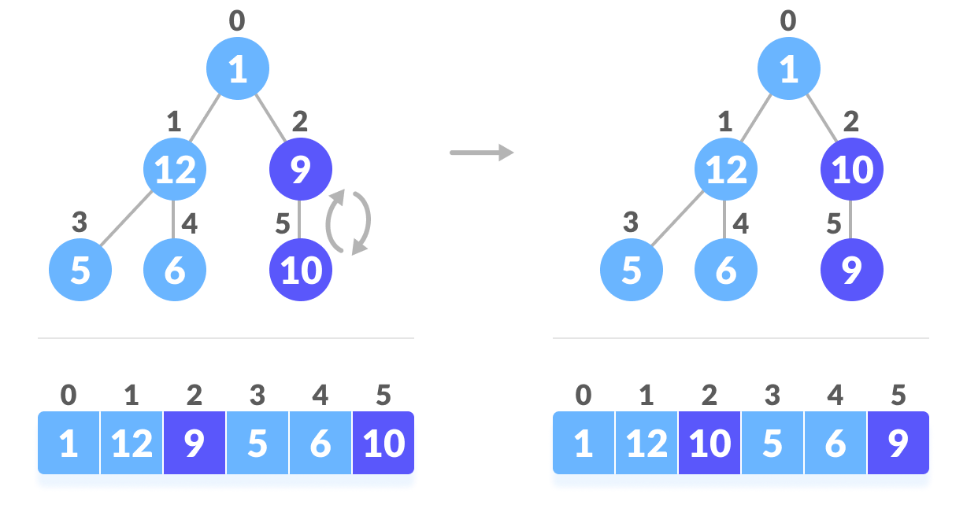
Steps to build max heap for heap sort
Figure 2: Heapify

Slide 26
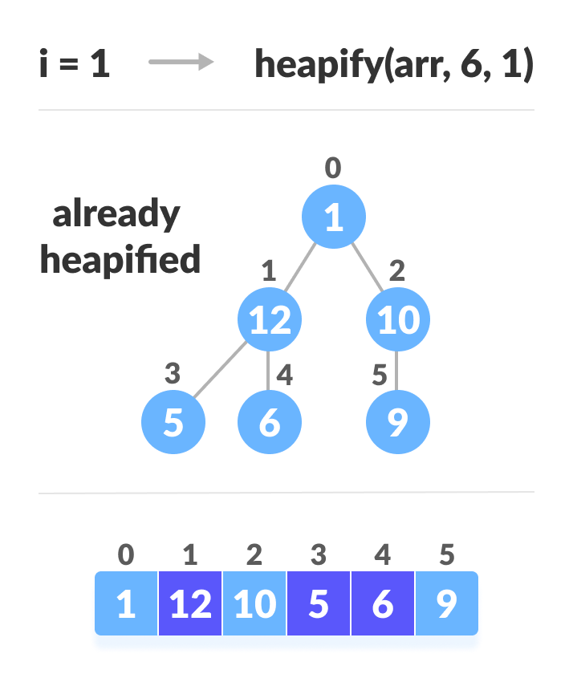
Steps to build max heap for heap sort
Figure 3: Heapify

Slide 27
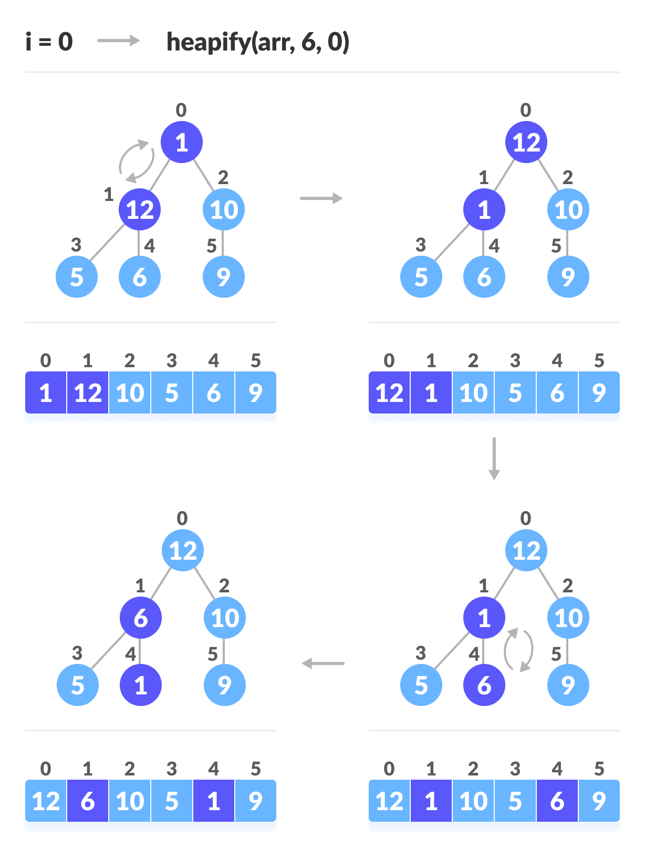
Steps to build max heap for heap sort

Slide 28

Contd..
Figure 4: Swapping

Slide 29

Contd..
Figure 5: Heapify

Slide 30

Contd..
Figure 6: Removing element

Slide 31

Contd..
Figure 7: Swapping

Slide 32

Contd..
Figure 8: Heapify

Slide 33

Contd..
Figure 9: Removing element

Slide 34

Swap, Remove and Heapify

Slide 35

Example
Sort the given array using Heap Sort method.

Slide 36
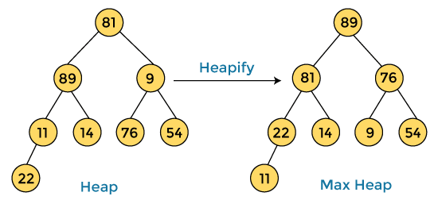

Example
a

Slide 37
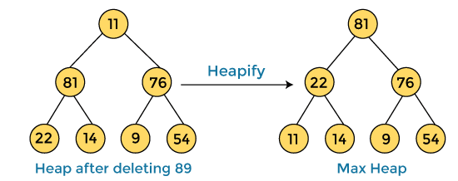

Example
a

Slide 38
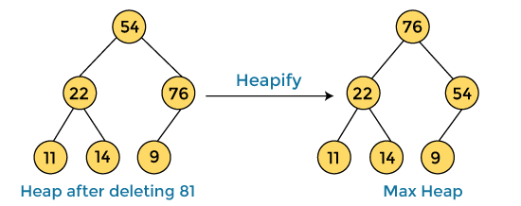

Example
a

Slide 39
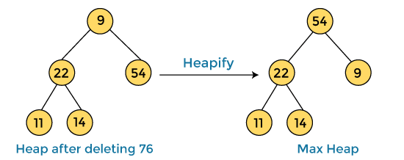

Example
a

Slide 40
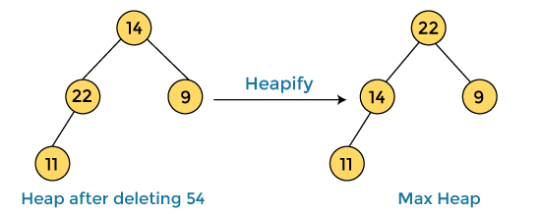

Example
a

Slide 41
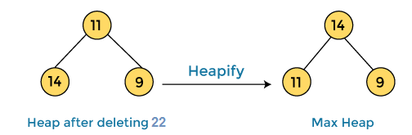

Example
a

Slide 42
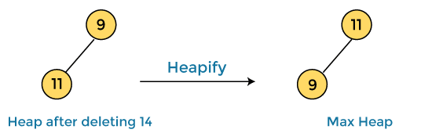

Example
a

Slide 43
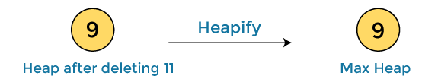

Example
a

Slide 44


Example
a
After completion of sorting, the array elements are -

Slide 45
References
http://epgp.inflibnet.ac.in/epgpdata/uploads/epgp_content/S000007CS/P001064/M014960/ET/1459249858E17.pdf
https://www.studytonight.com/data-structures/heap-sort
https://www.interviewbit.com/tutorial/heap-sort-algorithm/
Books:
Introduction to Algorithms by Coreman, Leiserson, Rivest, Stein.
Fundamentals of Algorithms by Ellis Horwitz, Sartaj Sahni, Sanguthevar Rajasekaran

Slide 46
References
http://epgp.inflibnet.ac.in/epgpdata/uploads/epgp_content/S000007CS/P001064/M014960/ET/1459249858E17.pdf
https://www.studytonight.com/data-structures/heap-sort
https://www.interviewbit.com/tutorial/heap-sort-algorithm/
Books:
Introduction to Algorithms by Coreman, Leiserson, Rivest, Stein.
Fundamentals of Algorithms by Ellis Horwitz, Sartaj Sahni, Sanguthevar Rajasekaran

Slide 47
THANK YOU
For query: gurpreetkaur.uic@cumail.in

